Slide 1
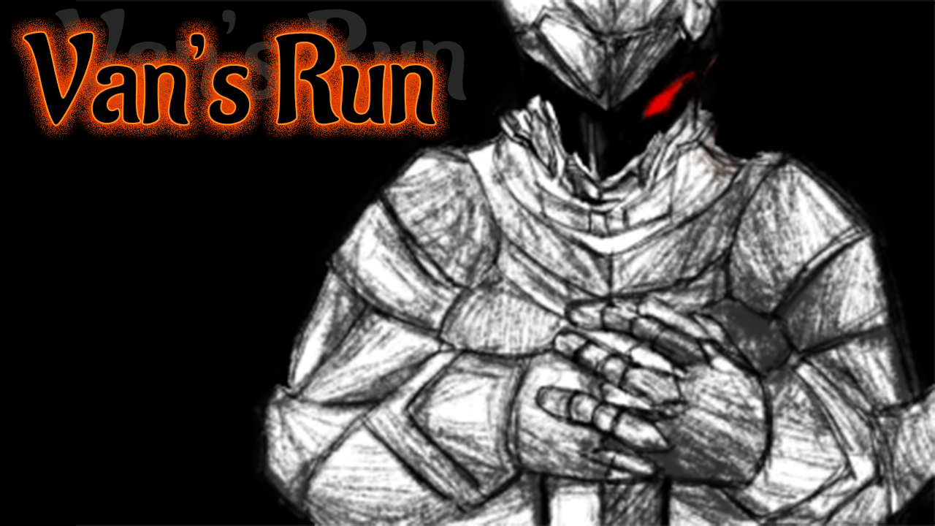
B977028 배선우, B977029 이주연

Slide 2
Van’s Run?
Running game for over 15 years old gamers.
In game hero is Van.
Van want to be a 『Dungeon Master』
So he starts his journey for his wish.

Slide 3
How to play

Slide 4

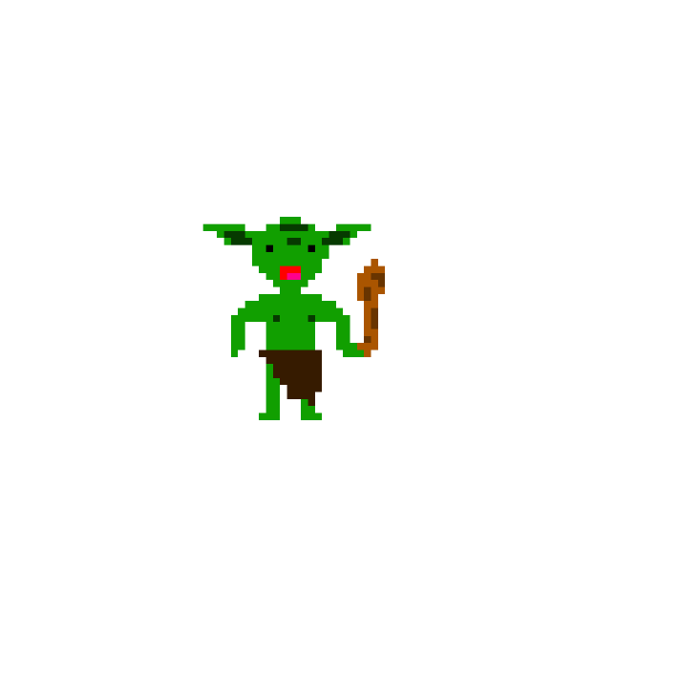

Mobs
bee
goblin
spike

Slide 5

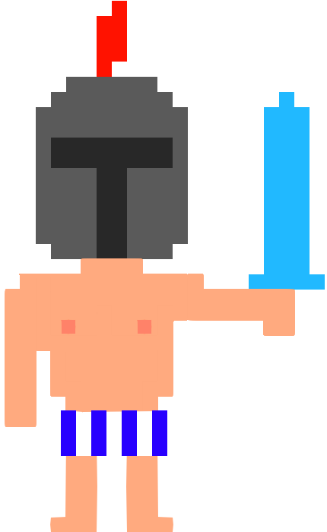
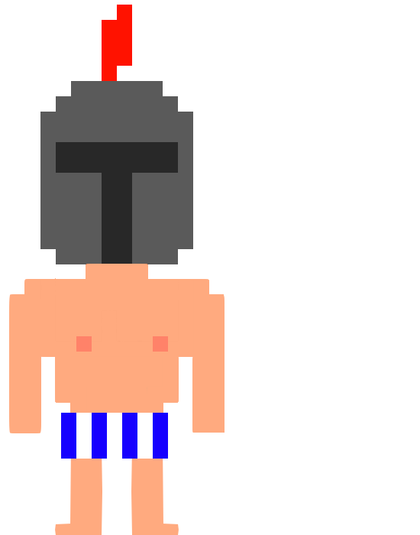
Van

Slide 6

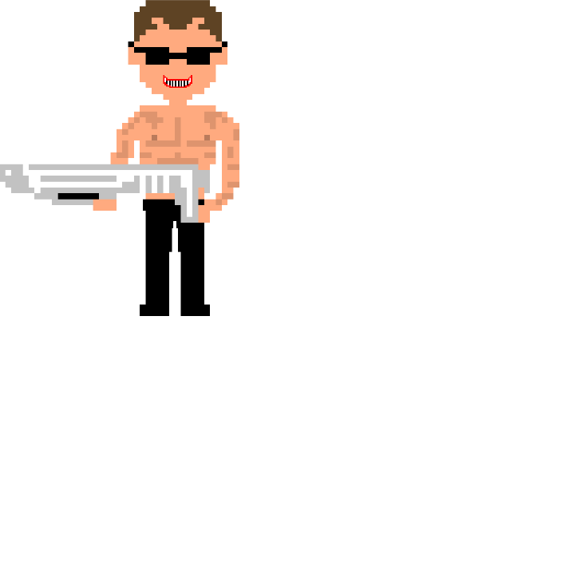
Boss
sweater
bullet

Slide 7
Title image - sister
Sound edit and Font art – 배선우
Sprite and Promote – 이주연
Coding and PPT - together

Slide 8
Thanks for listening!

